Slide 1
Java Reflection

Slide 2

Learning Objectives Exception
java.lang.Class
java.lang.reflect.Field
java.lang.reflect.Method
java.lang.reflect.Constructor
java.lang.reflect.Modifier

Slide 3
Introduction
Java Reflection is a process of examining or modifying the run time behavior of a class at run time.
Java.lang.class
The java.lang.Class class performs mainly two tasks:
provides methods to get the metadata of a class at run time.
provides methods to examine and change the run time behavior of a class.
Ways to get class
Class.forName()
Object.getClass()
Class.class

Slide 4
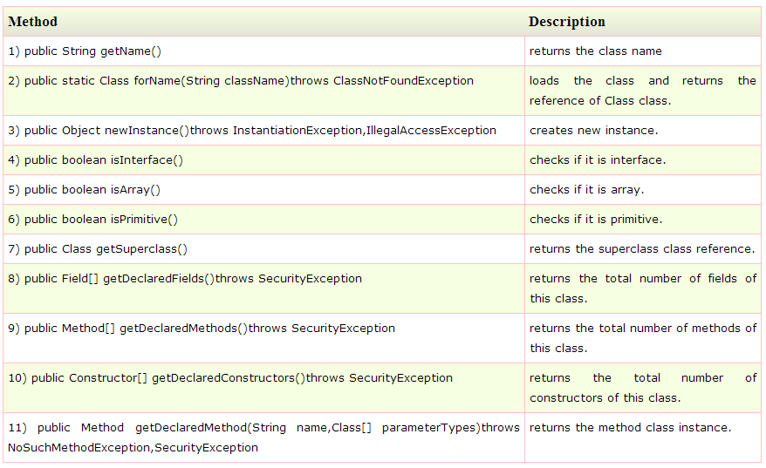
java.lang.Class

Slide 5
java.lang.Reflect.Field
A Field provides information about, and dynamic access to, a single field of a class or an interface. The reflected field may be a class (static) field or an instance field.
Methods
getDeclaredField()
getField()
getDeclaredFields() --All the fields, regardless of their accessibility
getFields() -- All the public fields up the entire class hierarchy

Slide 6
java.lang.Reflect.Method
A Method provides information about, and access to, a single method on a class or interface. The reflected method may be a class method or an instance method
Methods
getDeclaredMethod()
getMethod()
getDeclaredMethods() --All the method regardless of their accessibility
getMethods() -- All the public method up the entire class hierarchy

Slide 7
java.lang.Reflect.Constructor
Constructor provides information about, and access to, a single constructor for a class.
Methods
getDeclaredConstructors()- All the constructor regardless of their accessibility
getConstructors() - All the public constructor up the entire class hierarchy

Slide 8
java.lang.reflect.Modifier
The Modifier class provides static methods and constants to decode class and member access modifiers.
Methods
isPublic()
isPrivate()
isProtected()
isFinal()
isVolatile()
isStatic()

Slide 9
What are we learning in Next Chapter ?
Java Bean
Bean Properties
Bean Methods
Bean Events

Slide 10
Thank You !

